Slide 1
CONFEDERATION OF REAL ESATE DEVELOPER’ ASSOCIATION – MADHYA PRADESH
CREDAI ECGC CONFERENCE
Impact of GST on Real Estate Transactions
R. S. Goyal, Tax Consultant, Indore
Email: goyalrs@gmail.com
Present Scenario
After the Supreme Court's Judgment K Raheja Development and Larsen & Toubro Limited’s case
a. Ratio deal
in case a developer/builder construct the building on the land of land owner consumes building material purchase from registered dealer, from unregistered dealer or from the supplier of other state then in such a situation, it is immaterial that the builder has entered in to an agreement with prospective buyer or not the developer who constructed the building on the land of the land owner, will be liable to pay tax on the sale value of material supplied/used in the execution of works contract and the developer who holds the sales tax registration, will be eligible for claim of tax paid sales, before the implementation of VAT Act and will be eligible for ITR after implementation of VAT Act.

Slide 2
Construction of building on his own land & sales of constructed building or part thereof, after completion.
The builder is not liable for tax in other state but liable to pay tax on the capital value of the
building or part thereof u/s 9-B of M.P. VAT Act, as from 01.04.11.
In case the builder constructed the building on his own land and entered into contract with prospective buyer then in such a situation the builder is liable to pay tax on the material supplied/used in the execution of works contract at the rate applicable on sales of such goods.
Collection of Tax by builders & developers.
Ratio Deal:- In case building is constructed by A (Developer) on the land of B then A can recovered the actual VAT payable by him, from the Customer.

Slide 3
In case the building is constructed by the builder and he entered in to an agreement with prospective buyer then also he can recovered the actual VAT payable by him from the Customer.
But in any case, the amount of the VAT to be recovered, should not be more than the amount of tax payable.
If the builder/developer/contractor got certain work done with sub-contractor and sub-contractor pays the tax on the turnover of the goods supplied in the execution of works contract then also the main contractor will not be liable to pay tax on such turnover.

Slide 4
Liability of Tax on constructed of building intended for sale before its completion under GST regime.
The following activity related to construction will be treated as supply of services under GST regime:-
2.1 Constructed of complex, building, Civil structure or part thereof, intended for sale before its completion is being treated as supply of services as per schedule-II of Model GST Law.
2.2 Any lease tenancy, easement and license to occupy land.
2.3 Any lease or letting out of the building including a commercial, industrial or residential complex for business or commerce, either wholly or partly.

Slide 5
2.4 Renting of immovable property shall be treated as supply of services.
2.5 Works contract including transfer of property in goods (whether as goods or in some other form) involved in the execution of a works contract.
In case of construction of complex or building (wholly or partly) for which entire consideration received after issuance of completion certificate shall be out of the purview of the GST.
The treatment of land under GST regime.
To understand the treatment of land involved in the construction activity, we have to go through the definition of goods and services given in Model GST Law.
“Goods” means every kind of immovable property other than money and securities but includes actionable claim, growing crops, grass and things attached to or forming part of the land which are agreed to be severed before supply or under a contract of supply.

Slide 6
“Goods” means every kind of immovable property other than money and securities but includes actionable claim, growing crops, grass and things attached to or forming part of the land which are agreed to be severed before supply or under a contract of supply.
“Service” means anything other than good;
on perusal of the aforesaid definition, it is crystal clear that, the Land is not covered, in the definition of goods hence by friction of Law, it is (Land) is covered under the definition of services for the purpose of levying GST.
There is no deduction is allowable for portion of Land included in the construction of building.
The builder may be liable for GST @ 12% on entire value of complex or building constructed for sale before receipt of completion certificate.

Slide 7
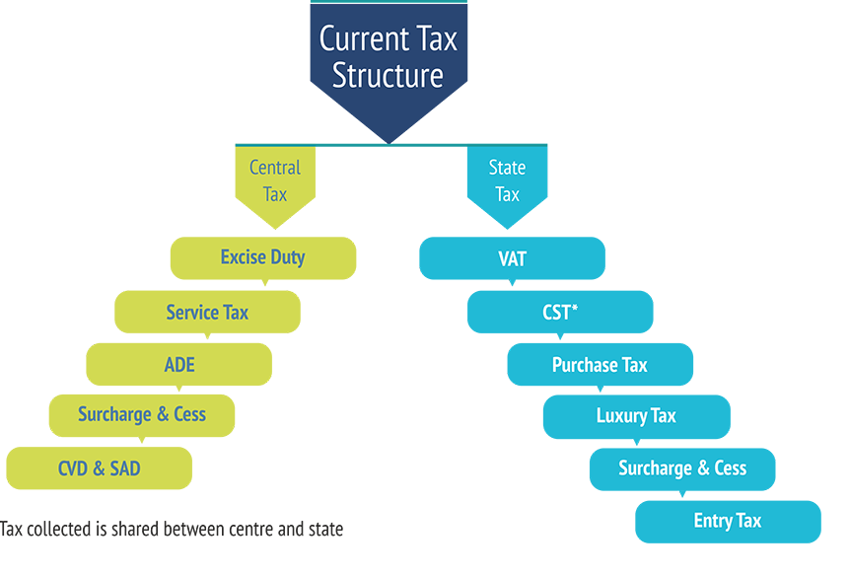
Subsuming of various indirect taxes in GST Regime

Slide 8
Removal of cascading effect of Taxes (Tax on Tax)
S.No. | Particular | Amount | Basic Tax | Cascading effect
1 | Sales value of Goods | 100.00
2 | Excise Duty @ 12 % | 12.00 | 12.00
3 | TOTAL | 112.00
4 | CST @ 2 % | 2.25 | 2.00 | 0.25
5 | Freight | 1.00
6 | TOTAL | 115.25
7 | Entry Tax @ 2% | 2.30 | 2.00 | 0.30
8 | TOTAL | 117.55
9 | Gross Profit @10% | 11.75
10 | TOTAL | 129.30
11 | VAT @ 14% | 18.10 | 14.00 | 4.10
12 | Final Sales value | 147.40 | 30.00 | 4.65

Slide 9
Taxes levied by Central | Rate of Excise Duty | Allowability of ITC/ CENVAT Allowable
 |  | Under VAT Regime | Under GST Regime
Central Excise Duty |  | CENVAT of Central Excise Duty not allowable to Builders/ Works Contractor | ITC of CGST Allowable to Builders/ Works Contractor
Cement | 10% | Not Allowable | Allowable
Steel | 15%
Electrical goods | 10%
Tiles | 10%
Sanitary | 10%
Plywood | 12.5%
Hardware | 12.5%
Paint | 12.5%

Slide 10
Taxes levied by Central Govt. | Rate of Excise Duty | Allowability of ITC/ CENVAT Allowable
 |  | Under VAT Regime | Under GST Regime
CST | Purchases Against C Forms | ITR of CST not allowable to Builders/ Works Contractor | ITC of CGST Allowable to Builders/ Works Contractor
On Purchase of all material used in the construction of Building | 2% | Not Allowable | Allowable As CGST

Slide 11
Taxes levied by Central Govt. | Rate of Excise Duty | Allowability of ITC/ CENVAT Allowable
 |  | Under VAT Regime | Under GST Regime
Service Tax |  | CENVAT Credit of Service Tax not allowable | ITC of CGST Allowable
On Purchase of all material used in the construction of Building | 4.5 | Not Allowable | Allowable As CGST

Slide 12
Taxes levied by State Govt. | Rate of Excise Duty | Allowability of ITC/ CENVAT Allowable
 |  | Under VAT Regime | Under GST Regime
VAT |  | ITR of VAT allowable to Builders/ Works Contractor | ITC of SGST Allowable to Builders/ Works Contractor
Cement | 14% | Allowable | Allowable As SGST
Steel | 5%
Electrical goods | 5% & 14%
Tiles | 5%
Sanitary | 14%
Plywood | 5%
Hardware | 5%
Paint | 14%

Slide 13
Taxes levied by State Govt. | Rate of Excise Duty | Allowability of ITC/ CENVAT Allowable
 |  | Under VAT Regime | Under GST Regime
Entry Tax |  | ITR of Entry Tax not allowable to Builders/ Works Contractor | Entry Tax Act will be discontinued on the implementation of GST
On Purchase of all material used in the construction of Building | 1 to 2% | Not Allowable | Not Payable Under Regime

Slide 14
Present Scenario
 | Per Sq. Ft. | Vat | Service Tax | Total of Vat & Ser. Tax | Total
Sale Value of Flat | 2300 | 122 | 104 | 226 | 2526
Less : Proportionate Value of Land | -500 | 0 | 0 | 0 | -500
Net Value (Cost of Construction + Estimated Profit) | 1800 | 0 | 0 | 226 | 2026
Sale Price | 2300
Less:- 70% Abatement | -1610
Taxable Value for Service Tax | 690
Service Tax @ 15% | 104

Slide 15
Present Scenario
 | Labour @ 40% | Material @ 60% |  |  |  | Total
 |  | Rate of Tax of Various Material
Tax Rate |  | 14% 70% | 5% 10% | 5% 20% | Mat. Val 100%
Sales Value Incl. Vat & Service Tax | 824 | 862 | 113 | 227 | 1202 | 2026
Less:- Element of Vat / Service Tax included in Sales Price | -104 | -106 | -5 | -11 | -122 | -226
Net Purchase Price | 720 | 756 | 108 | 216 | 1080 | 1800
Less:- Estimated Profit | -120 | -126 | -18 | -36 | -180 | -300
Cost of Construction | 600 | 630 | 90 | 180 | 900 | 1500

Slide 16
Present Scenario
Cost of Construction | 600 | 630 | 90 | 180 | 900 | 1500
Less:- Element of Vat Included in Purchase (Allowable as ITR Under Vat Act) | 0 | -77 | -4 | -9 | -90 | -90
 | 600 | 553 | 86 | 171 | 810 | 1410
Less:- Avg Excise Duty 10% (No ITR Allowable for Central Excise Duty) | 0 | -55 | -9 | 0 | -64 | -64
Net Value | 600 | 497 | 77 | 171 | 746 | 1346

Slide 17
Present Scenario
Particular | Vat | Service Tax | Total
Liability of Vat & Service Tax | 122 | 104 | 226
Less:- ITR Allowable | -90 | 0 | -90
Net Liability of Tax | 32 | 104 | 136
Note:- The Purchase Price includes CST @ 2% Paid by the Supplier, while making purchase from Out of State.

Slide 18
Projected Scenario of Tax under GST regime
 | Per Sq. Ft. | GST @ 12% | Total
Sale Value of Flat | 2300 | 276 | 2576
 | Labour @ 40% | Material @ 60% |  |  |  |  | Total
 | Rate of Tax of Various Material
GST Rate | 18% | 28% 50% | 18% 30% | 5% 20% | Mat. Value 100% | Land
Sales Value Incl. Vat & Service Tax | 806 | 605 | 363 | 242 | 1210 | 560 | 2576
Less:- Element of Vat included in Sales Price | -86 | -65 | -39 | -26 | -130 | -60 | -276
Net Purchase Price | 720 | 540 | 324 | 216 | 1080 | 500 | 2300

Slide 19
Rate of Tax Various Material
Net Purchase Price | 720 | 540 | 324 | 216 | 1080 | 500 | 2300
Less:- Estimated Profit | -120 | -90 | -54 | -36 | -180 | 0 | -300
Cost of Construction | 600 | 450 | 270 | 180 | 900 | 500 | 2000
Less:- Element of GST Included Purchase of Goods Allowable as ITC Under GST Regime) | -92 @18% | -98 @28% | -41 @18% | -9 @5% | -148 | 0 | -240
Net Purchase Price | 508 | 352 | 229 | 171 | 752 | 500 | 1760

Slide 20
Particular | Vat (in Rs.)
Liability of GST | 276
Less:- ITC Allowable | -240
Net Liability of Tax | 36
Particular | Amount (in Rs.)
Increase in ITC (ITC in GST 240/- - ITR of Vat 90/-) | 150
Less : Increase in Liability of GST (GST 276 - Vat + Service Tax -226) | -50
Reduction in Ultimate liability of Tax on Builder in GST | 100

Slide 21
Thank You

